Slide 1
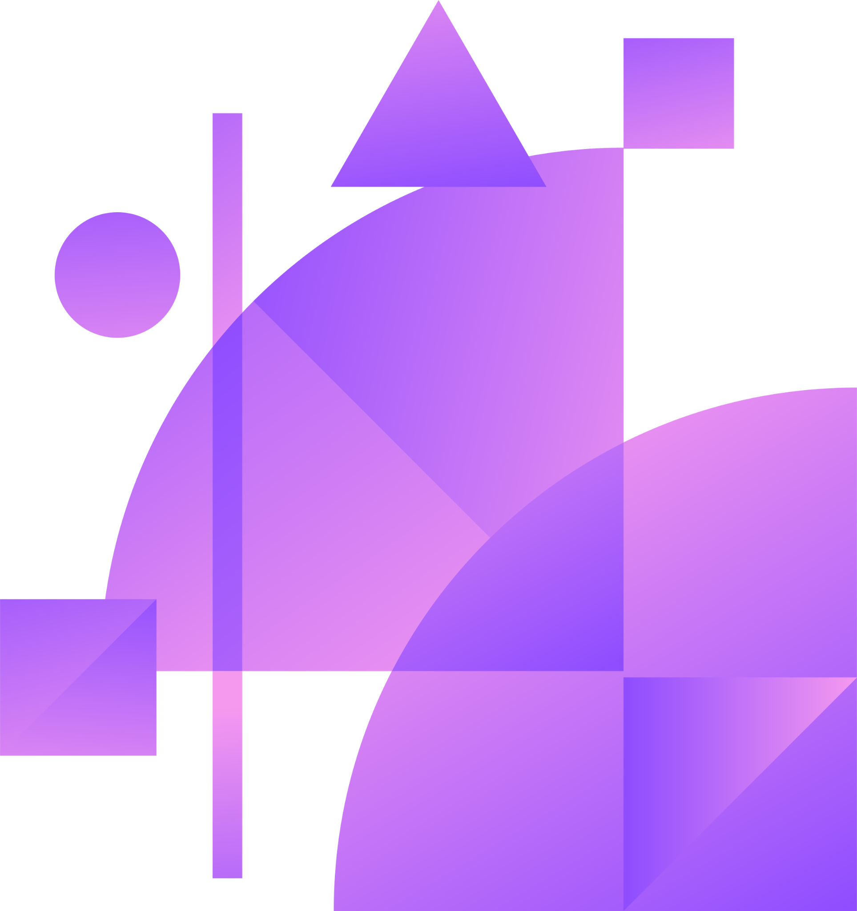
Legal Chatbot
Anitta Varghese Divya Kurava Kamruzzaman Kamrul Manoj Potnuru

Slide 2
Table of contents
01
02
03
04
05
07
Introduction
Data
ETL
Overview of services used
Architecture
06
08
09
10
11
Processing
Cypher
Visualization
Answer Retrieval
RAG
Conclusion & Demo
Notes:
Introduction
Data
ETL
Overview of services used
Architecture
Processing
Cypher
Visualization
Answer Retrieval
RAG
Conclusion & Demo

Slide 3
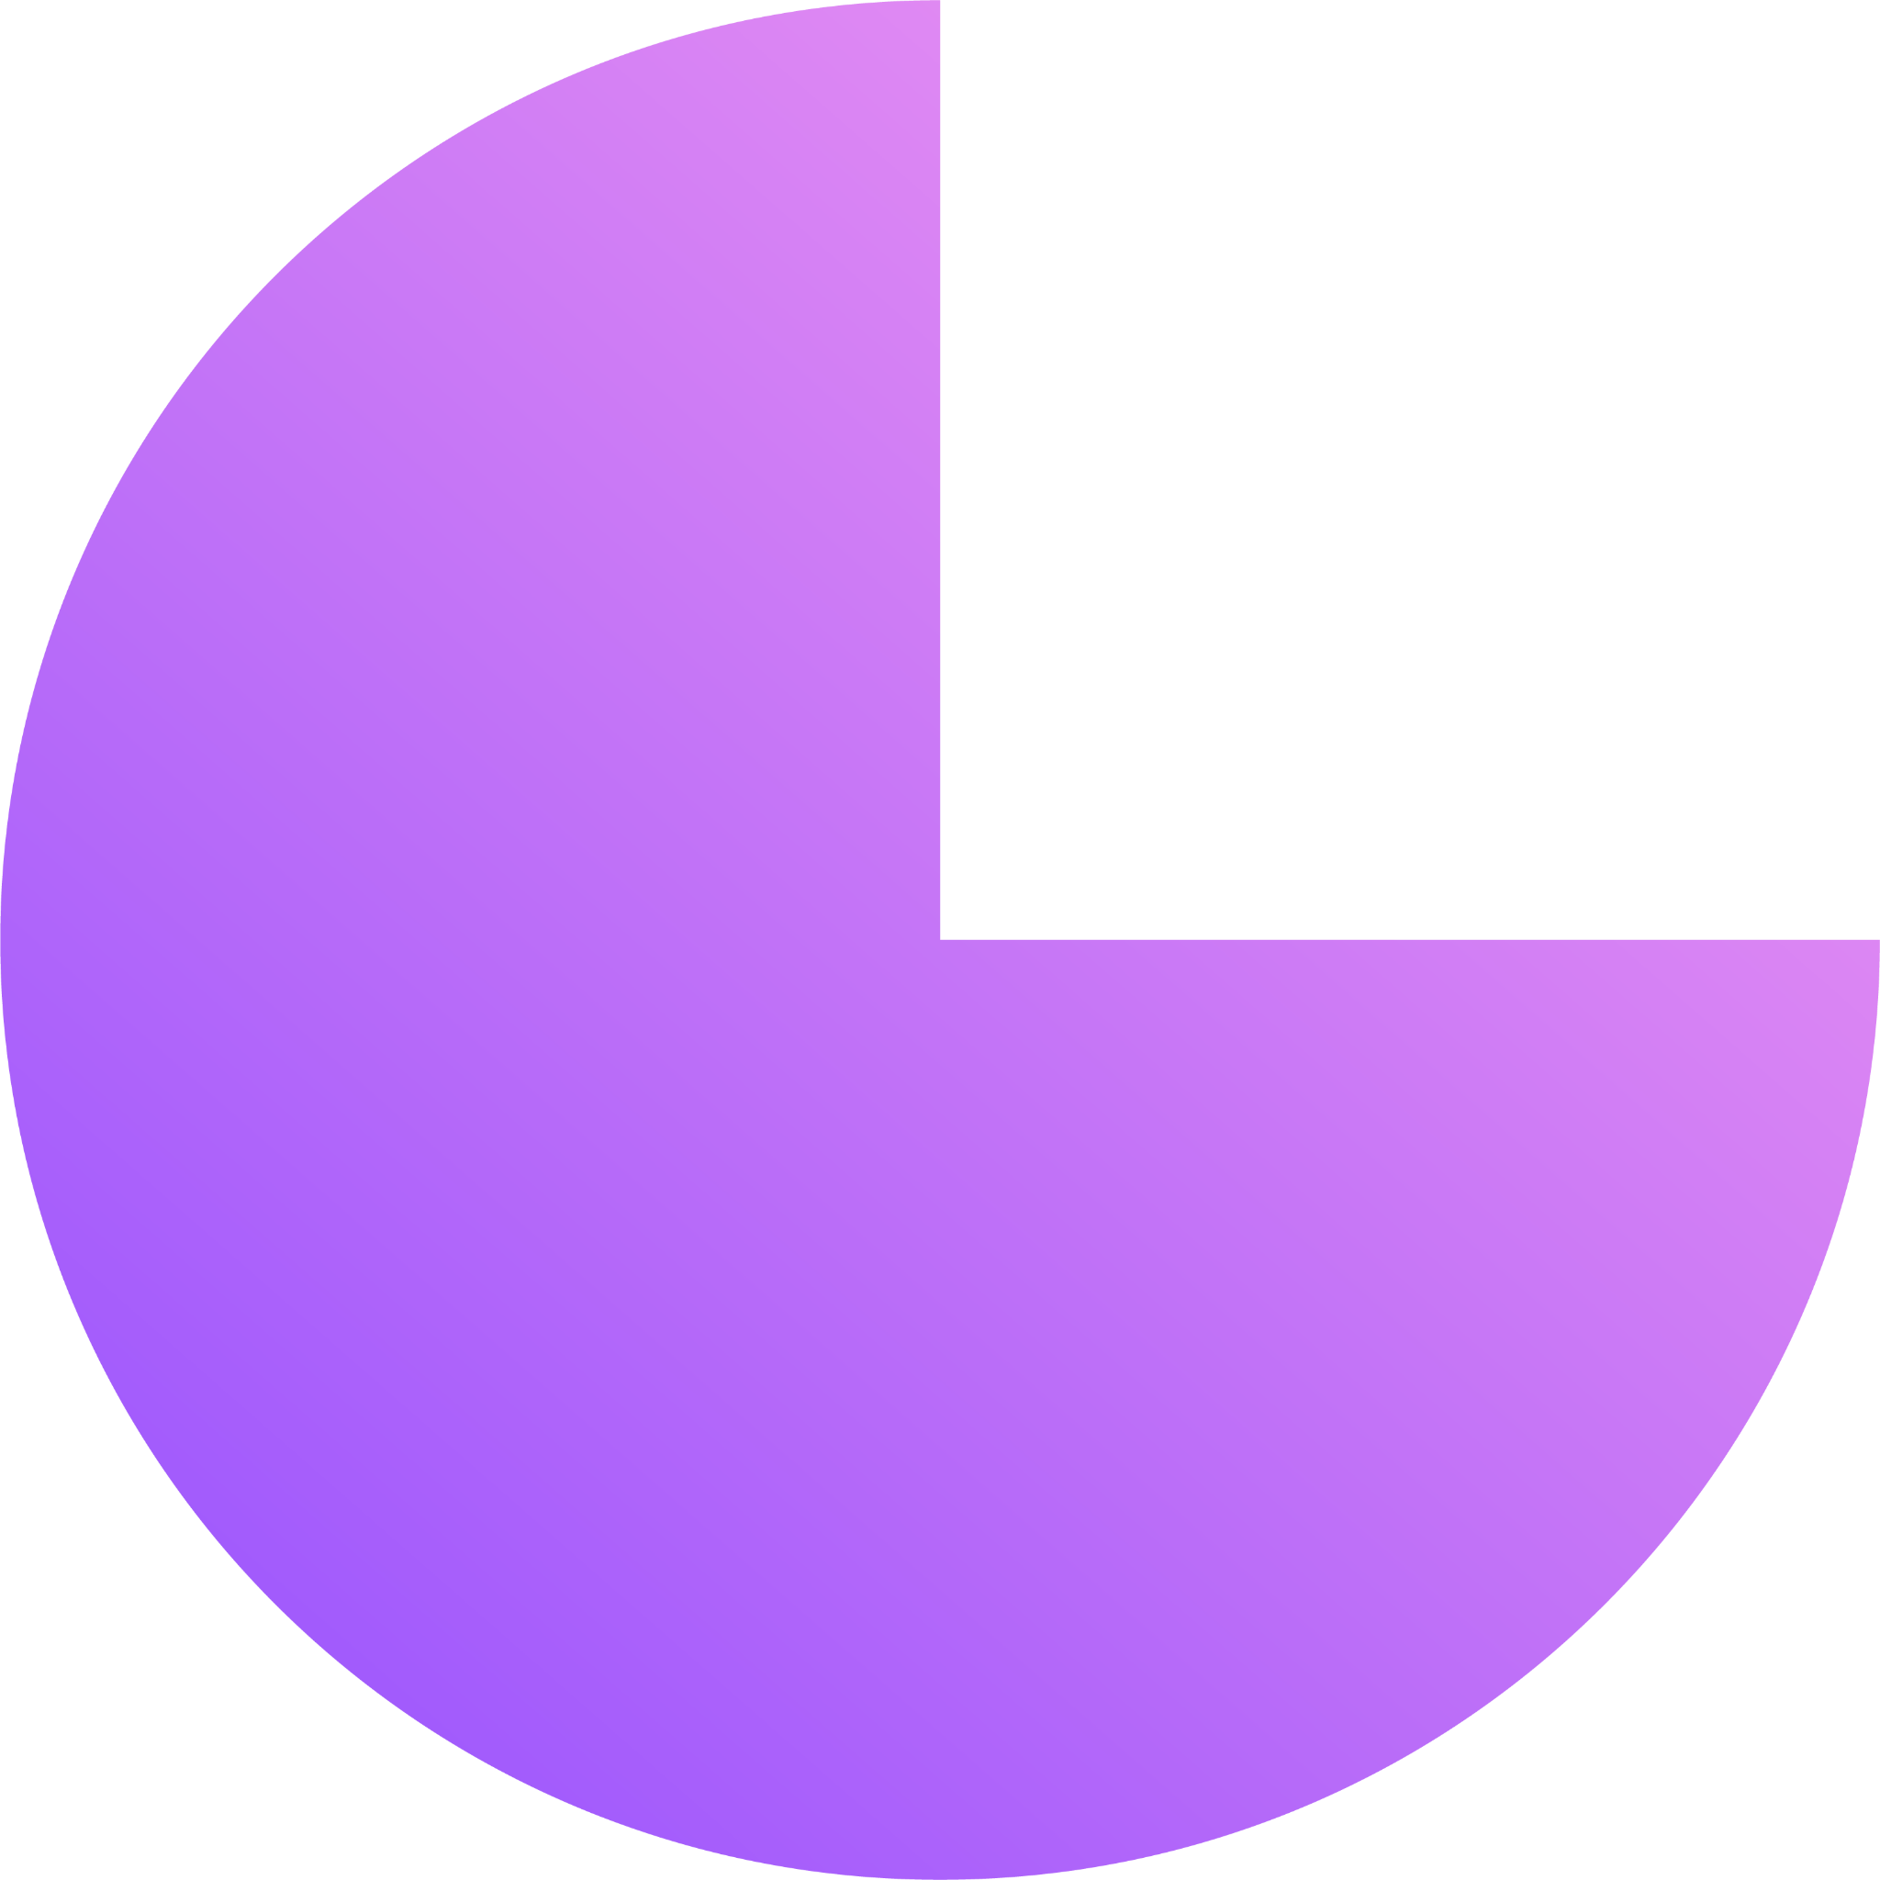

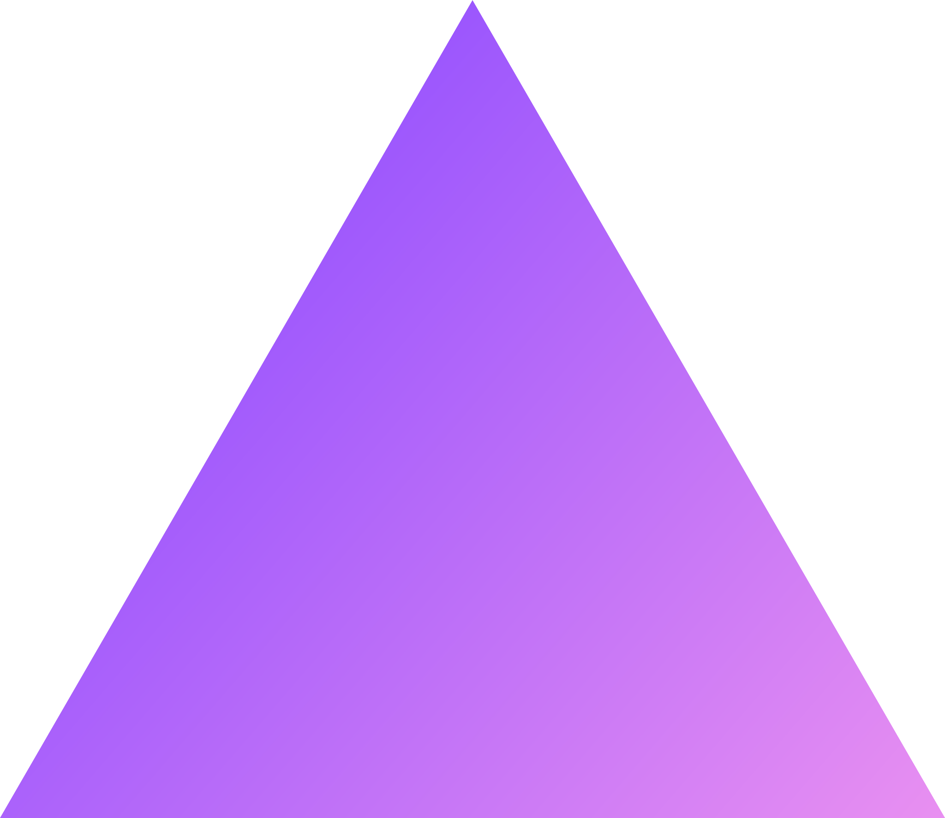
01 Introduction
Purpose: Create a specialized chat bot powered by LLM to assist users with Legal Queries
Design: Utilize LLMs to empower individuals to analyze Legal documents for enhanced Data Insights and Decision-making using Embedding-based search.
Target Audience: Serve a diverse user base including law students, legal researchers legal professionals and individuals seeking legal information by providing, dependable recall of legal data through the chat-bot, with the capacity to expand its utility beyond Legal laws.
Notes:
Introduction

Slide 4

02 Data Sourcing
Harvard Law School Library’s Caselaw Access Project
Decades of Published Law Precedents from Illinois in text, JSON and XML formats.
https://case.law/caselaw/
Notes:
Data Sourcing

Slide 5
03 ETL
EXTRACT | TRANSFORM | LOAD
• Identified the JSON files containing the relevant data for chatbot. • Used Python to read and parse the JSON files. • Extracted the necessary information from the selected attributes for each case. | •Defined the schema for Neo4j graph database, including node labels and relationship types. •Map the extracted data to the graph schema, converting entities and relationships into nodes and edges. | •Used the Neo4j Python driver to connect to Neo4j database from Python environment. •Executed cypher queries to create nodes and relationships in the Neo4j database based on the transformed data. •Load the data into the Neo4j graph database, ensuring that the graph structure accurately represents the relationships between entities.
Notes:
Data Transformation

Slide 6

04 Overview of services used
Langchain
Open AI
Text Splitter: Langchain provides the capability to split text into smaller chunks with metadata.
Retriever: Langchain integrates with OpenAI's API and Neo4j's Vector Index to create retrievers for information retrieval.
Vector Index: Langchain leverages Neo4j's Vector Index functionality to index text embeddings for efficient similarity searches.
OpenAI's encoding service: Utilized to convert text content from legal cases into vector representations.
Vector representation: Generated for each case to capture semantic meaning and context.
Case type determination: Facilitated through the vector representations, aiding in the classification of cases such as Murder, Theft, Arson, etc.
Notes:
For each case, the OpenAI GPT-3 model is invoked to classify the case into predefined categories such as Murder, Theft, Arson, etc.
The model is prompted with a system message describing the task and the user message containing the text of the case.
The response from the model is parsed, and the predicted case type is extracted.
The predicted case type is added to the case dictionary under the key 'case_type’.
Cypher query is used merge a new node representing a text chunk into the Neo4j graph database.
The MERGE statement ensures that a node with the specified chunkId does not already exist. If it doesn't exist, a new node is created with the provided properties.
Properties such as name, case_type, id, decision_date, source, court, chunkSeqId, and text

Slide 7
04 Overview of services used
GraphDB
Streamlit
Cypher queries: Employed to create new nodes in the Neo4j graph database, each representing a text chunk with associated properties.
Vector-based similarity search: Utilized to find similar nodes in the graph database based on cosine similarity of their text embeddings.
Streamlit: Empowers developers to build interactive web applications directly from Python scripts, enabling rapid development and deployment.
Notes:
For each case, the OpenAI GPT-3 model is invoked to classify the case into predefined categories such as Murder, Theft, Arson, etc.
The model is prompted with a system message describing the task and the user message containing the text of the case.
The response from the model is parsed, and the predicted case type is extracted.
The predicted case type is added to the case dictionary under the key 'case_type’.
Cypher query is used merge a new node representing a text chunk into the Neo4j graph database.
The MERGE statement ensures that a node with the specified chunkId does not already exist. If it doesn't exist, a new node is created with the provided properties.
Properties such as name, case_type, id, decision_date, source, court, chunkSeqId, and text

Slide 8
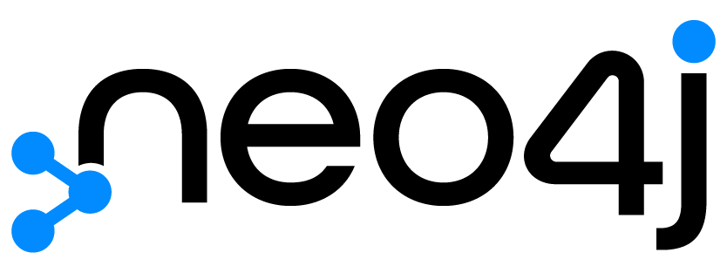
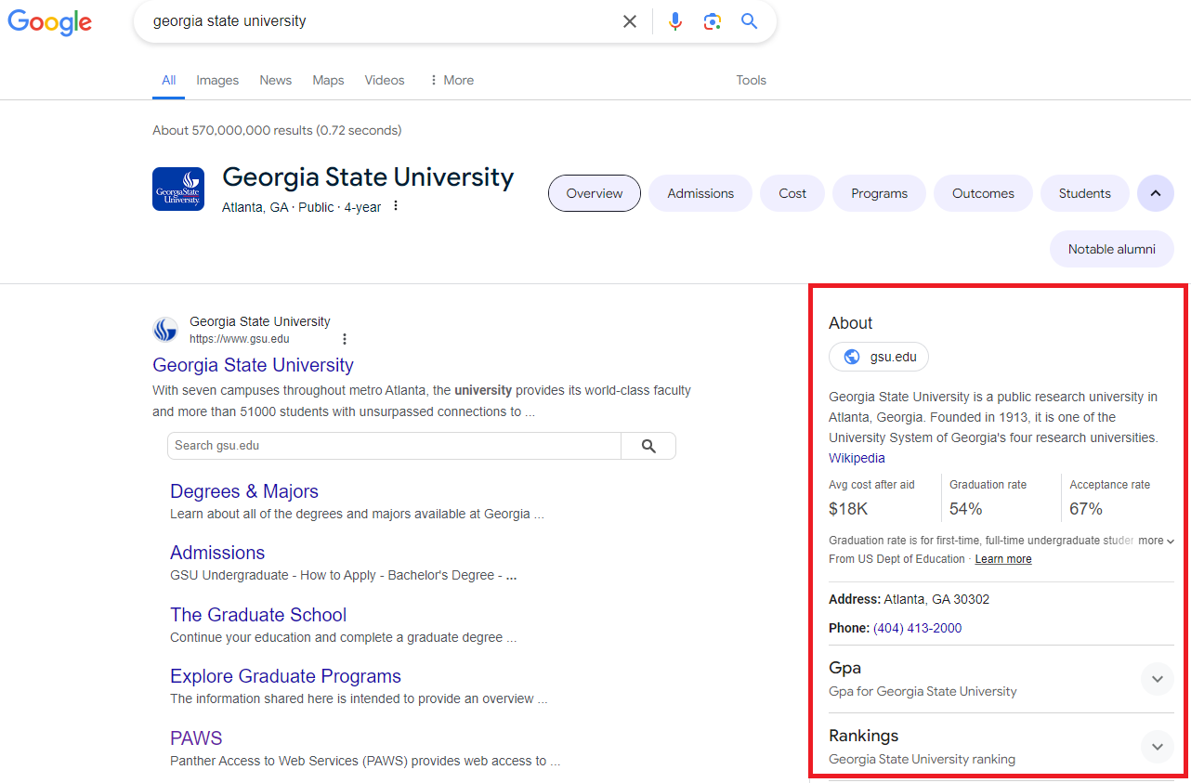
WHY GRAPH DB?
Complex Relationships
Contextual Understanding
Data Integration
Scalability
Notes:
For a chatbot handling legal queries and providing information about sentences for crimes such as murder, theft, and other legal matters, Neo4j may be more suitable. Here's why:
Complex Relationships: Legal systems involve intricate relationships between various entities such as laws, crimes, legal precedents, and sentencing guidelines. Neo4j's graph database capabilities excel in representing and traversing these complex relationships. You can model laws, crimes, sentencing guidelines, and legal precedents as nodes and edges in the graph, allowing the chatbot to navigate these relationships to provide accurate information about sentences for specific crimes.
Contextual Understanding: Legal queries often require contextual understanding and interpretation of legal terms and concepts. Neo4j's ability to model and analyze relationships between legal entities enables the chatbot to understand the context of the query and provide relevant information. For example, the chatbot can consider factors such as aggravating or mitigating circumstances, precedent cases, and sentencing guidelines when providing information about sentences for crimes.
Data Integration: Legal databases may contain diverse sources of information, including statutes, case law, legal commentary, and historical court decisions. Neo4j's flexibility in integrating and querying heterogeneous data sources makes it well-suited for consolidating and analyzing legal information from multiple sources. The chatbot can leverage this integrated data to provide comprehensive and accurate responses to legal queries.
Scalability: As legal databases continue to grow with new laws, court decisions, and legal precedents, scalability becomes crucial. Neo4j's ability to scale horizontally by distributing data across multiple servers ensures that the chatbot can handle large volumes of legal data and queries efficiently.

Slide 9
05 Architecture
Store embeddings with document chunk ID
Load Documents
Generate Document chunks
Vectorize chunks
Graph DB
Documents
Document Chunks
Embeddings
Vectorize question
Use question embedding to retrieve relevant document chunk ID
Question
Embedding
LLM
Document Chunks
Relevant document chunks
Use document chunk IDs to retrieve document chunks from storage
Generated answer
Answer
Notes:
Architecture

Slide 10
06 Document Processing
Document is split into Chunks
Each Chunk is vectorized/Embedded using OpenAI service
Store Embeddings with Doc chunk ID in Graph DB using Neo4J
To establish Relationship and introduce the Chunks to one another we use Cyphers
CREATE VECTOR INDEX `case_chunks` IF NOT EXISTS
FOR (c:Chunk) ON (c.textEmbedding)
OPTIONS { indexConfig: {
`vector.dimensions`: 1536,
`vector.similarity_function`: 'cosine'
}}
Notes:
Langchain – Part 1 – Embeddings, storage and Mapping

Slide 11
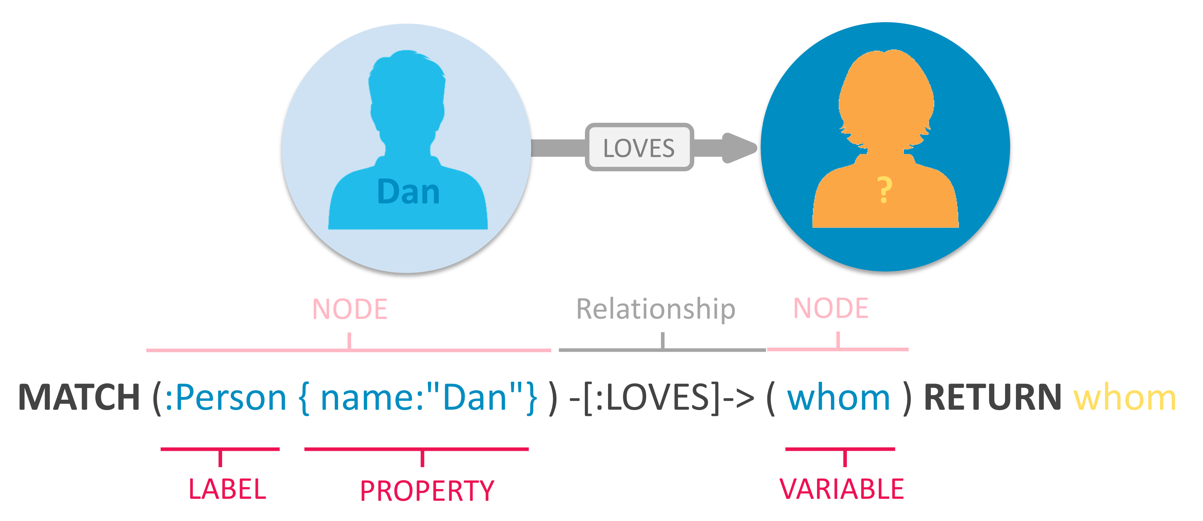
07 Cypher
Cypher is a query language for graph databases, and it's specifically designed to work with data stored in the graph format.
The graph database executes the Cypher query and traverses the graph to find all nodes and relationships that match the specified pattern. Cypher can be used as part of the retrieval component in RAG. When you execute a Cypher query against a graph database, you're effectively retrieving relevant nodes and relationships from the graph that match the query criteria.
Notes:
Cypher can be used as part of the retrieval component in RAG. When you execute a Cypher query against a graph database, you're effectively retrieving relevant nodes and relationships from the graph that match the query criteria.

Slide 12
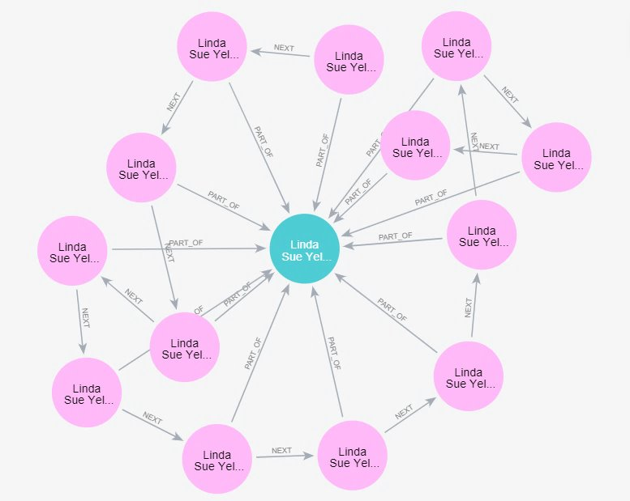
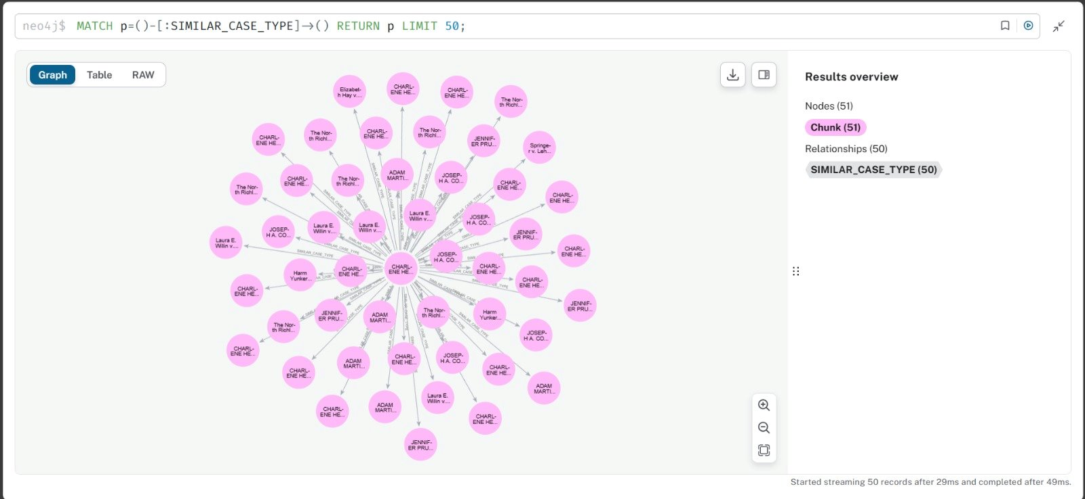
08 Visualization
Relationships established using Cypher
Notes:
Visualization

Slide 13
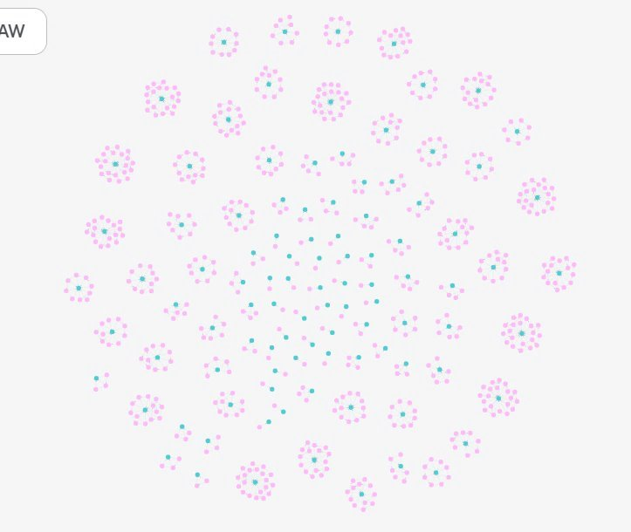

Slide 14
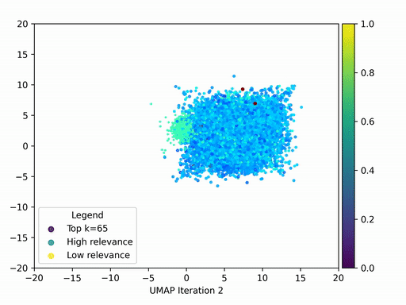
09 Answer Retrieval
Vectorize the Question
Retrieve closest chunk based on vector similarity
Question + Docs (Relevancy)
Answer the Question
Windowed Retrieval
Notes:
This graph shows a large language model using UMAP to visualize document relevance.
UMAP reduces complex data to 2D for easier viewing.
Each dot represents a document retrieved for a user query.
Horizontal position shows how the UMAP process categorized the document.
Vertical position shows how relevant the document is to the query (higher = more relevant).
Dot colors show how many documents were retrieved in total (e.g., top 10, top 65).

Slide 15
10 RAG
RAG is a model that combines retrieval and generation techniques to produce natural language responses to queries. Retrieval component finds relevant passages of text or documents. – use CYPHER Generation component generates a response based on the retrieved nodes and relationships can then be used as input to the generation component of RAG to generate a response.
The coordination between Cypher and RAG enables the chatbot to provide accurate and contextually relevant answers to user questions.
Retrieval Component
Generation Component
Response
CYPHER
Text/documents
Nodes & Relationships
Notes:
Windower Retrieval

Slide 16
demo

Slide 17
Thanks!
Do you have any questions?
Contact us at -
info@bettercallsaul.com
@glassmates.legal

